Slide 1

Introduction to MONet Data Types
Qian Zhao
Earth Scientist

Slide 2
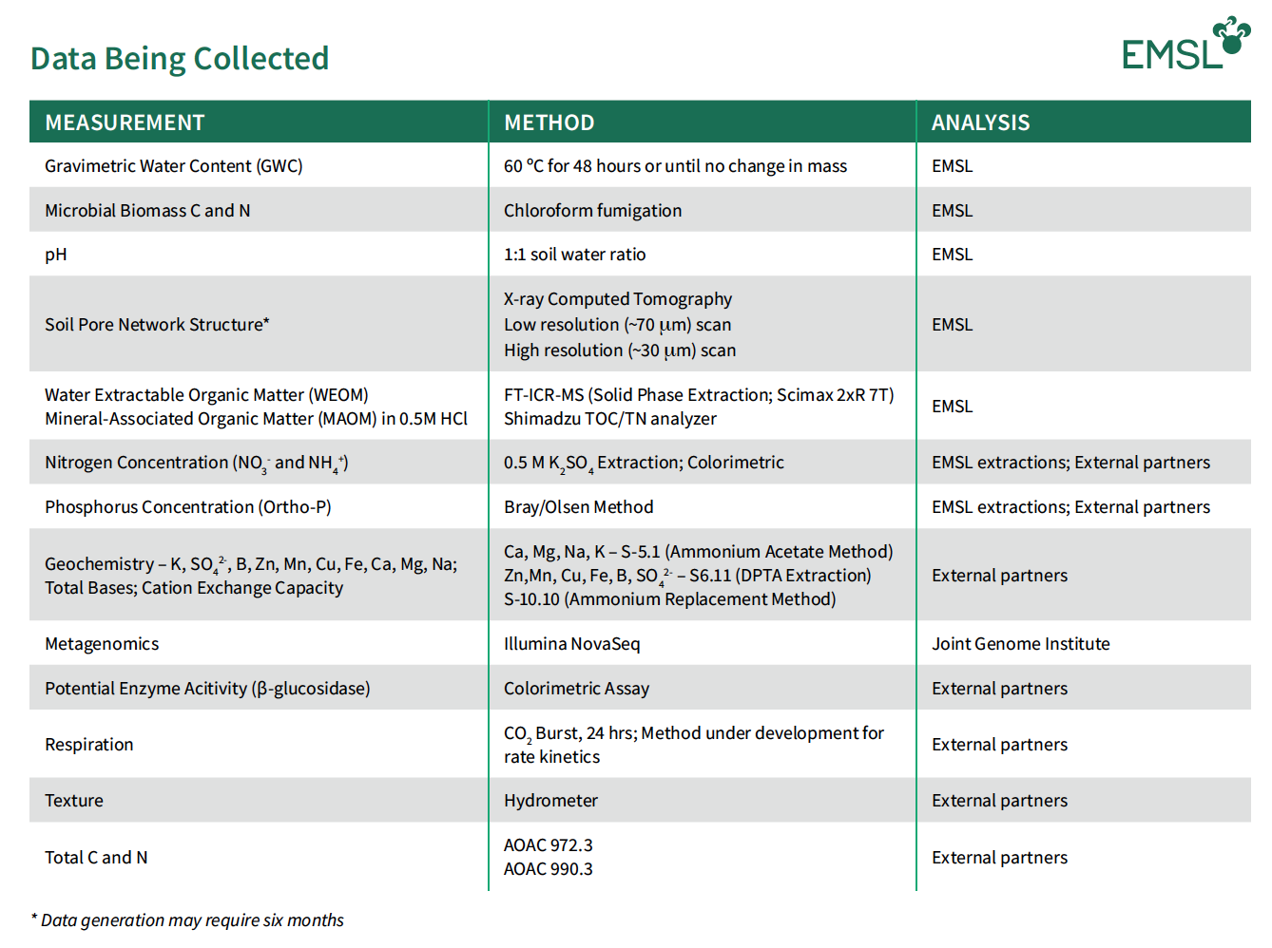
Data Being Collected
More than 30 different data types
https://www.emsl.pnnl.gov/monet

Slide 3
Data Being Collected
Biogeochemistry Analyses
https://www.emsl.pnnl.gov/monet

Slide 4
Data Being Collected
Physical property Analyses
https://www.emsl.pnnl.gov/monet

Slide 5
Data Being Collected
Molecular Analyses
https://www.emsl.pnnl.gov/monet

Slide 6
Data Being Collected
MONet Premier Analyses
https://www.emsl.pnnl.gov/monet

Slide 7
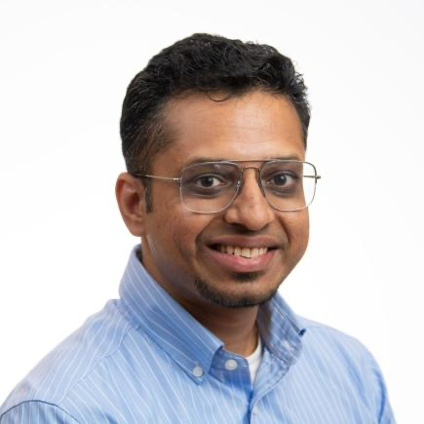
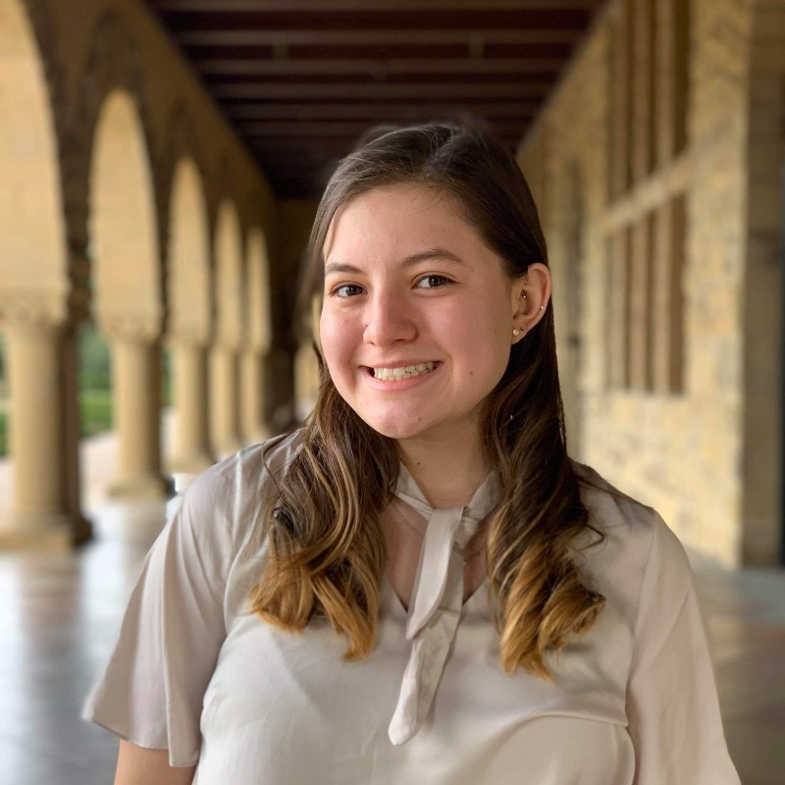


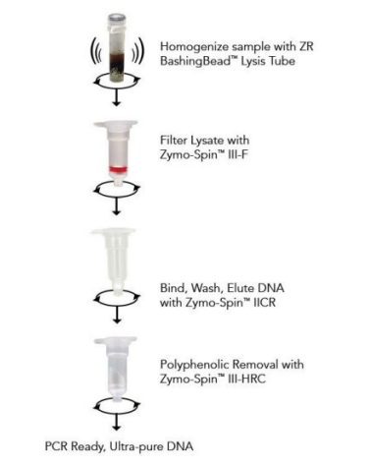
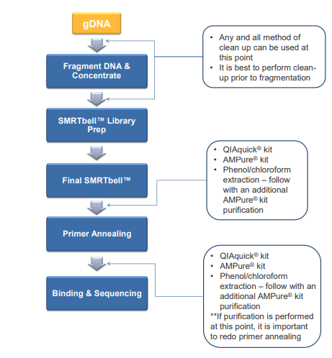
Metagenomics Sequencing Partnership with Joint Genome Institute (JGI)
Zymo Research Kit Product: D6010
DNA is extracted following manufacturer’s protocol
DNA is vortexed for 15 minutes .
Satish Karra
Izabel Stohel
Young Song
Samples are quantified on the nanodrop and sent to JGI for sequencing.

Slide 8
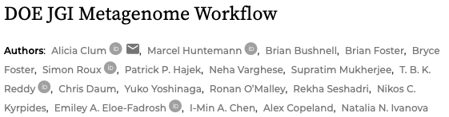






JGI Metagenome Program – Standard output
Sample QC
Library preparation
Sequencing & QC
DNA
sample
Assembly (metaSPAdes for metagenomes)
Read mapping
Genome binning (MetaBAT2) and QC
Filtered reads
Functional annotation (IMG pipeline)
All the MONet metaG data (raw data and processed data done by JGI) will be made available via the MONet portal.
Metagenome
MGM workshop: https://mgm.jgi.doe.gov/
2021 webinar series: https://mgm.jgi.doe.gov/img-webinar-series/
Save the Date: the 2024 JGI Annual Meeting Sept. 30-Oct. 4, 2024 https://usermeeting.jgi.doe.gov/

Slide 9

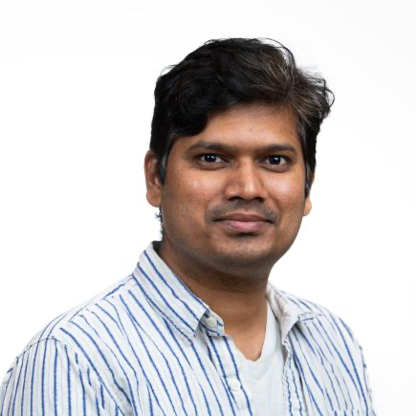
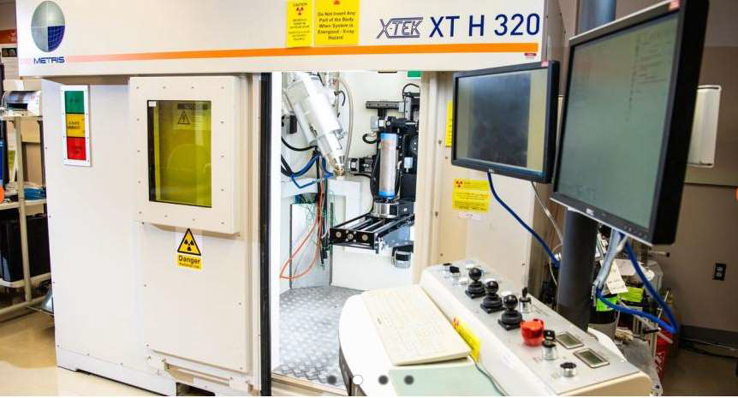
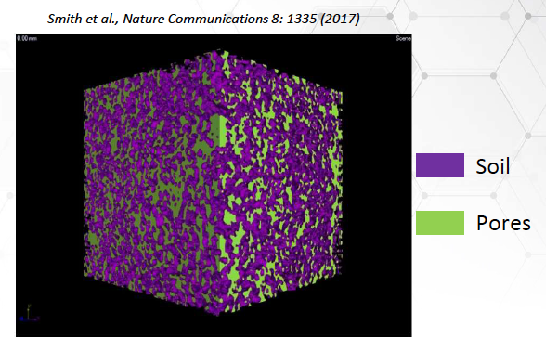
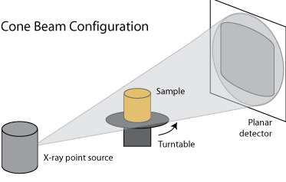
Soil Pore Network Structure X-ray Computed Tomography (XCT)
XCT is a non-destructive X-ray imaging to examine/visualize the internal microstructure of objects
Tamas Varga
Anil Krishna Battu
http://serc.carleton.edu/images/research_education/geochemsheets/techniques/_1172960774.png
Notes:
Tamas will cover: Fundamentals, Examples, How XCT data (Pore networks data) can be used on modeling.

Slide 10
XCT Data Processing Flowchart
Image acquisition
Image reconstruction
Cropping to exclude “wall” air space and constrain to pre-set volume
Outputs: porosity, pore volume, pore diameter, connectivity, permeability, flow rate, etc.

Slide 11

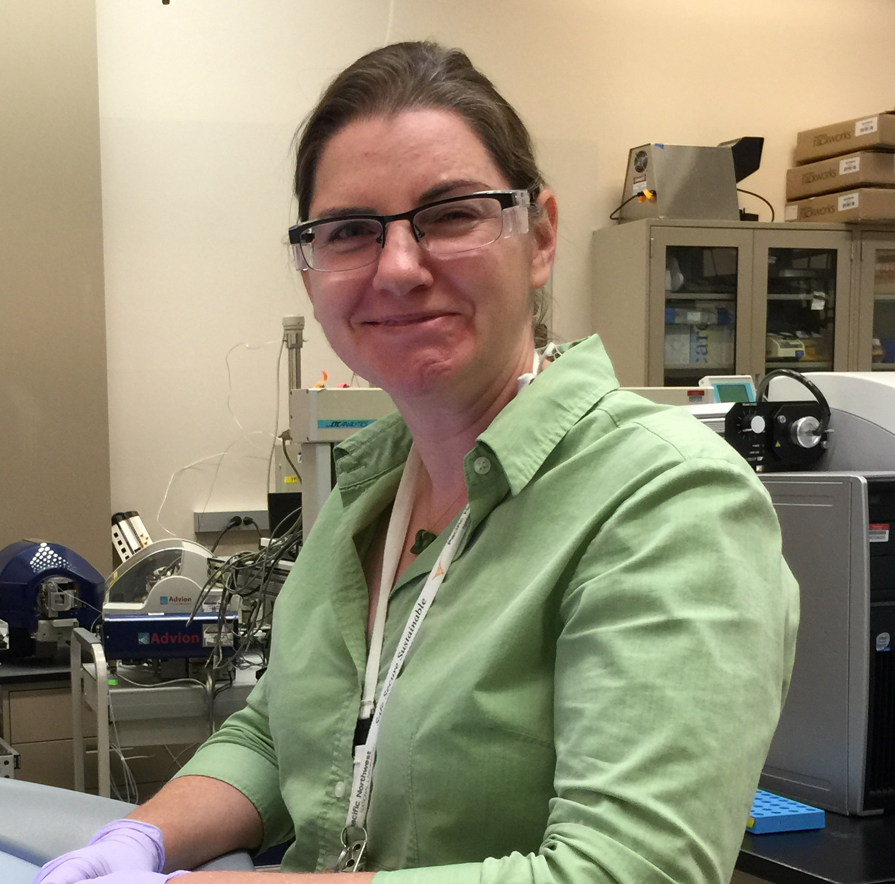
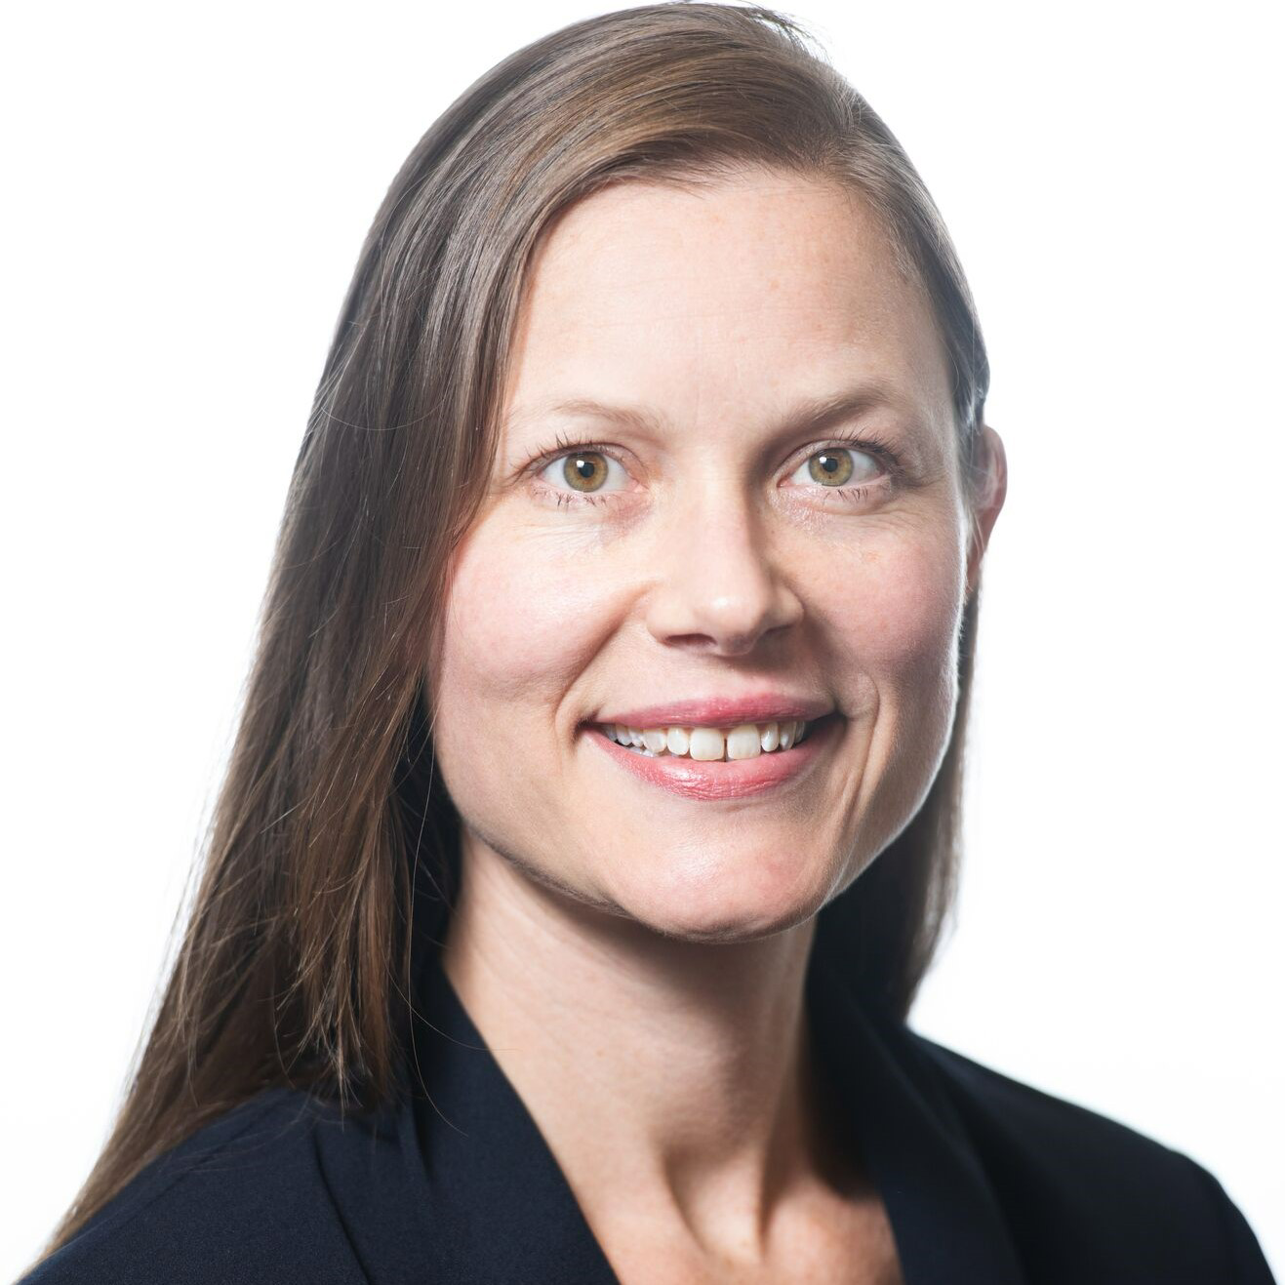
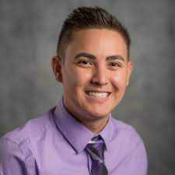
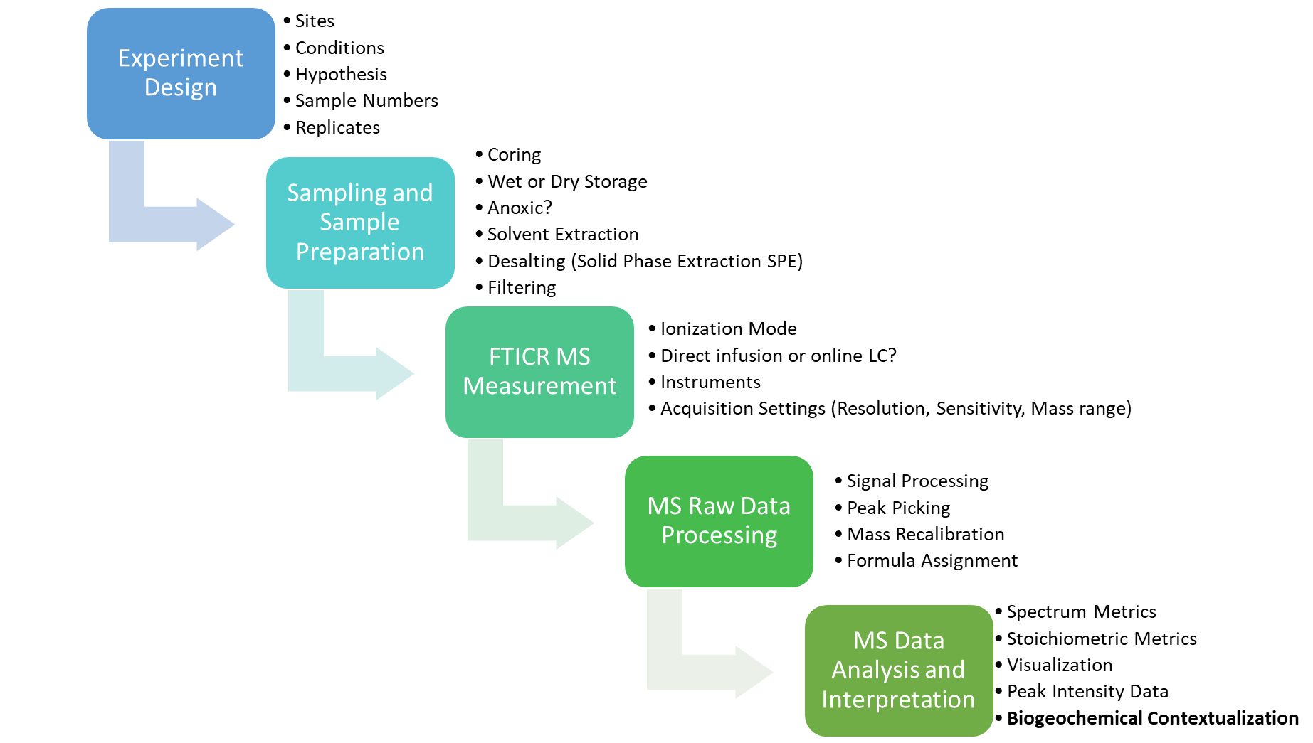
Organic Matter Molecular Composition FT-ICR-MS
William Kew
Rosalie Chu
Nicole DiDonato
Jason Toyoda

Slide 12
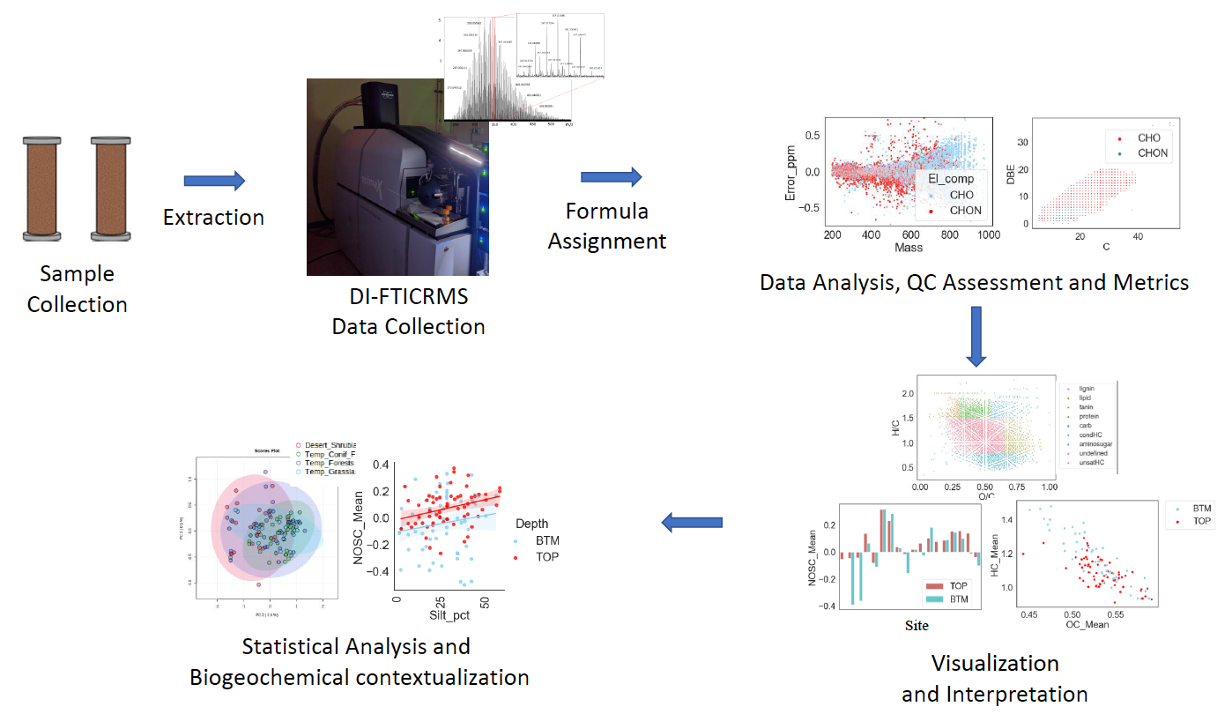
FT-ICR-MS Data Processing Flowchart

Slide 13
Data Being Collected
MONet Premier analyses
https://www.emsl.pnnl.gov/monet

Slide 14

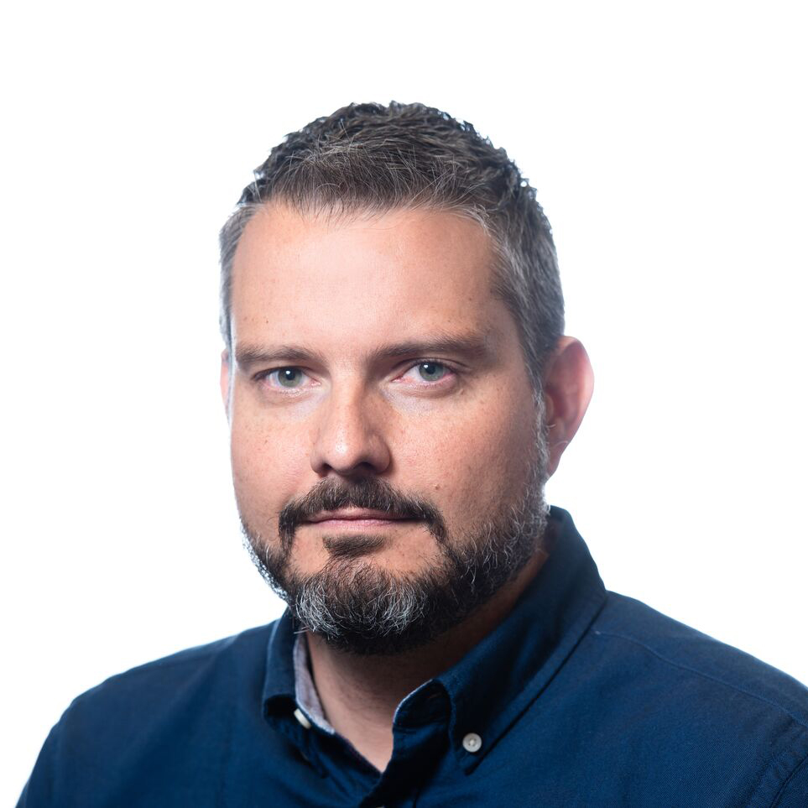
Coming next…
8:35 a.m. Update on MONet Data Model & Access Gateway
Yuri Corilo| Computational Scientist | EMSL
Notes:
Key timelines.
First timeline, MONet pilot in FY22 called “1000 soils” lead by Emily Graham.
Focused on soil OM chemistry, metagenomes and microscale measurements, used to learn from our successes and also challenges.
1000s soils data collected and uploaded at the end of FY22 and is ongoing.
Second timeline is the launch of MONet as a User Program. Our overall goal for FY23 was to successfully launch the first MONet Soil function call. Second year goal, will be to “nail it” by delivering all the elements that are still in development (hyprop, LC-MS, artic cores, data model)
Third timeline: accelerate the pace of the program and initiation of biogenic emission pilot program.

